Slide 1

Android Application Market on Play store
Yalin Tekin
Nekkanti Sahani
Tianer Qi
Chandana Udupa

Slide 2
Index
Problem Identification​
Proposed Solution
Data sources, Tools & Methodology​
NOSQL – Neo4J
PySpark​
Conclusions

Slide 3



Problem Identification​
Predict the ratings of the App (before/after launching it on Play Store)
This analysis will help the app development industry and the business to decide on new products and next release by providing insights
Find correlation between two or more variables
Notes:
DATA CLEANING\\ EXPLORING THE APPLICATION CATEGORIES\\
DISTRIBUTION OF APPLICATION RATINGS\\ SIZE AND PRICE OF THE APPLICATION\\
CORROLATIN BETWEEN APPLICATION CATEGORY AND PRICE\\
POPULARITY OF PAID APPLICATIONS AND FREE APPS\\
SENTIMENT ANALYSIS OF THE USER REVIEWS

Slide 4



Data sources, Tools & Methodology
DATA SOURCE
NoSQL
SPARK
Dataset for the project is from the Kaggle website-
googleplaystore.csv
googleplaystore_user_reviews.csv
Data design-
Created 3 nodes (Application, Category & Application_User_Review) and 2 relationships (Belongs_To, Reviewed
).
Used PySpark to find the correlation between two or more variables from the data set to determine success factor of an application

Slide 5
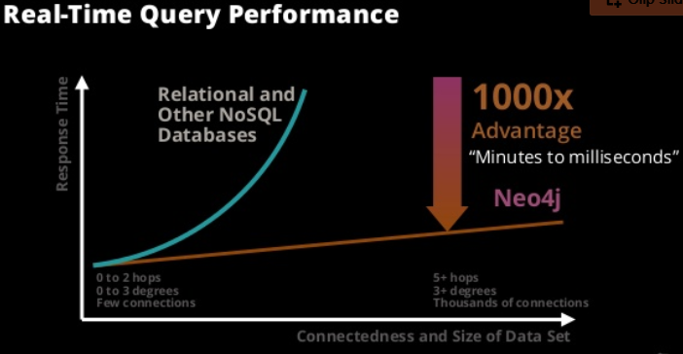
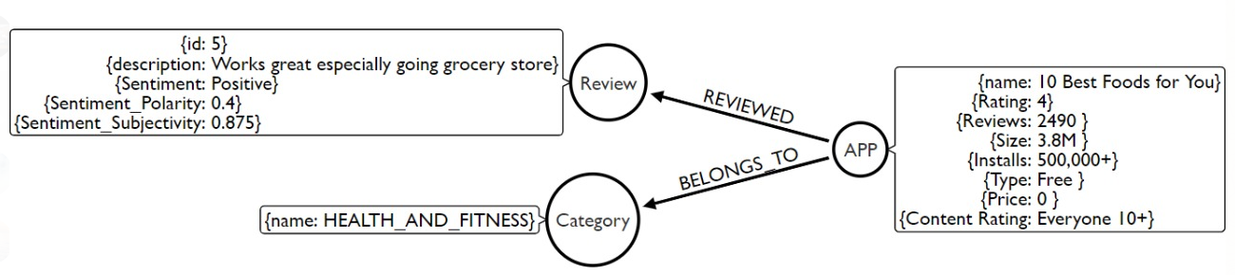
Neo4j
Why Neo4j?
Data design
• Faster database operations
• More flexible
• With the increase in the reviews of the application, the speed of database operations will not decrease.
• The structure of the entity relationship is very natural & fits the intuitive feeling of human beings.
NODES =>
I) APPLICATION
II) CATEGORY
III) APPLICATION_USER_REVIEW
RELATIONSHIPS => BELONGS_TO, REVIEWED

Slide 6
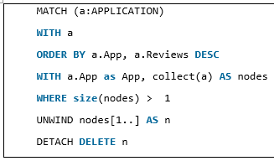

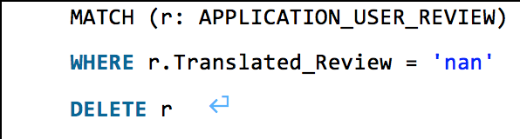
Neo4j
Data Cleaning – Identification of duplicate rows (same app names with different review count) and removal of the same and 'nan' value
Created the constraint on Application name for it to be unique in future also
Deleted 12022 nodes, deleted 12022 relationships, completed after 1064 ms.
Deleted 26863 nodes, completed after 238 ms.
Neo4j will automatically create an index. Cypher will use that index for lookups just like other indexes

Slide 7
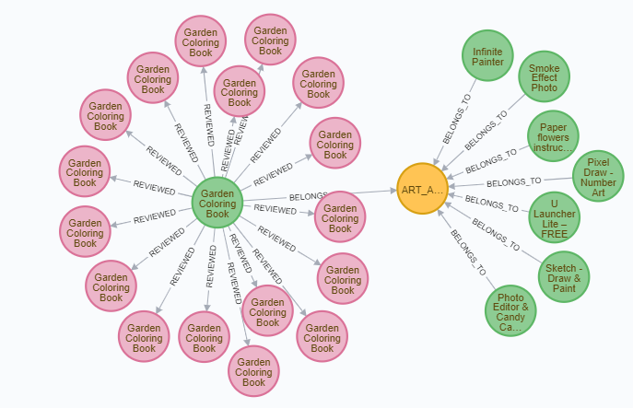
Neo4j
Final data storage in Neo4j by data modelling

Slide 8
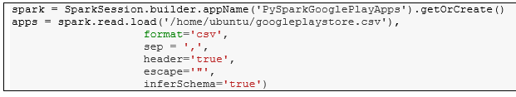
PySpark
Tools used for set up - Amazon EC2, Jupyter Notebook, putty
Steps followed are-
Importing libraries
Dataset loading
Transformations and data type conversions using “withColumn”
Column renaming: Removing spaces.
Rating: Cast to Double.
Installs: Apply regexp to remove unwanted characters and cast to Integer.
Price: Apply regexp to remove unwanted characters and cast to Double.
Last updated: Cast to Date.

Slide 9
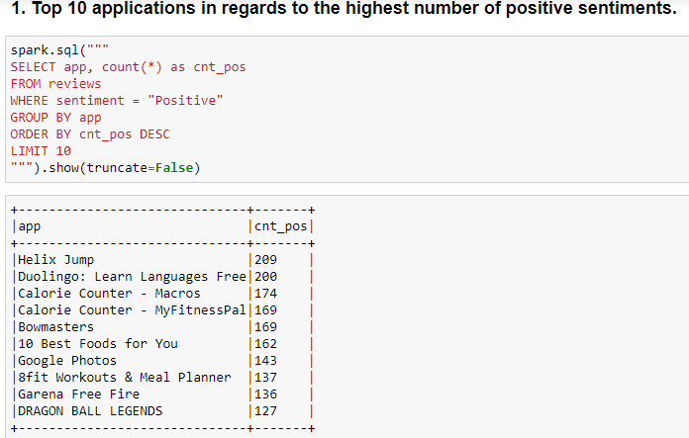
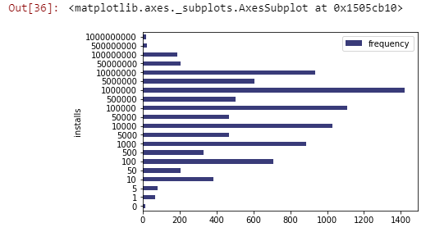
PySpark
Top 10 applications regarding the highest number of positive sentiments
Histogram for the number of installations

Slide 10
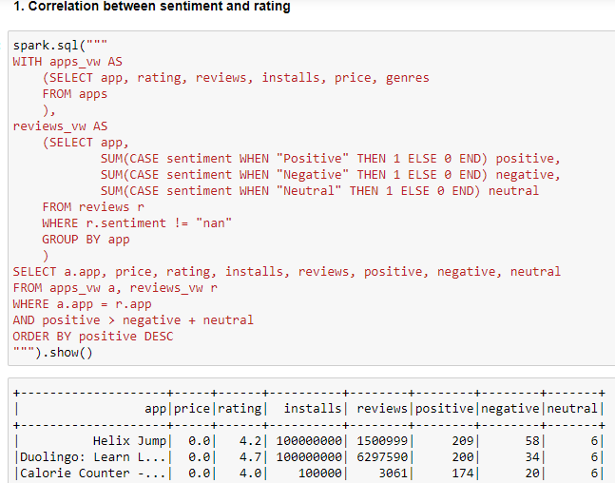
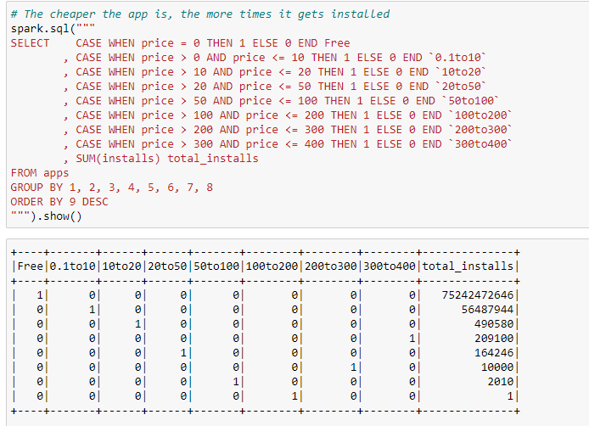
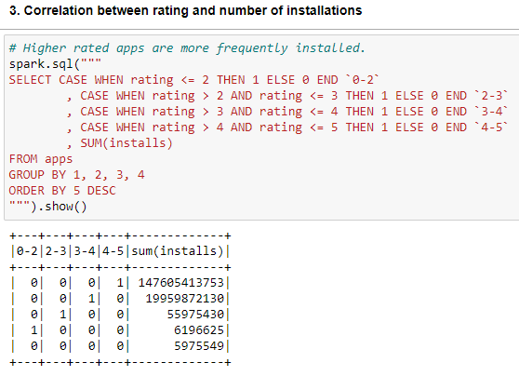
PySpark
Correlation between different variables-
Sentiment & Rating Price & Number of installations Rating & Number of installations

Slide 11
Conclusion & Future Work
KEY INSIGHTS:
Data cleaning & constraint usage
Correlation between ‘Rating’ and the other columns, we can perform a simple prediction.
The most expensive apps are not frequently installed
Higher rated apps are more frequently installed
FUTURE WORK :
Enlargement of dataset for accurate insights
Code to connect neo4j from PySpark
Implement machine learning for sentiment analysis of the apps

Slide 12

THANK YOU

